Slide 1
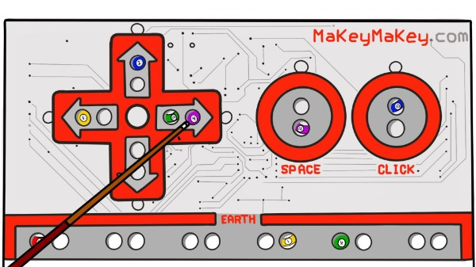
Makey Your Shot
Taylor Williams, Asho issak, JOhnson ngao, SAMUEL GROOM
Notes:
Created by: Taylor Williams

Slide 2
Description of TAP program
The Technology Ambassadors Program is a program that offers students opportunities to learn more about technology, and help them develop creativity, leadership, communication, and teamwork skills.
It also gives them the opportunity to do outreach with their projects so that children of all ages can get interested in different technologies.
The outreach will help TAP students build their leadership skills and make them gain public speaking confidence.
Notes:
Created by: Taylor Williams

Slide 3
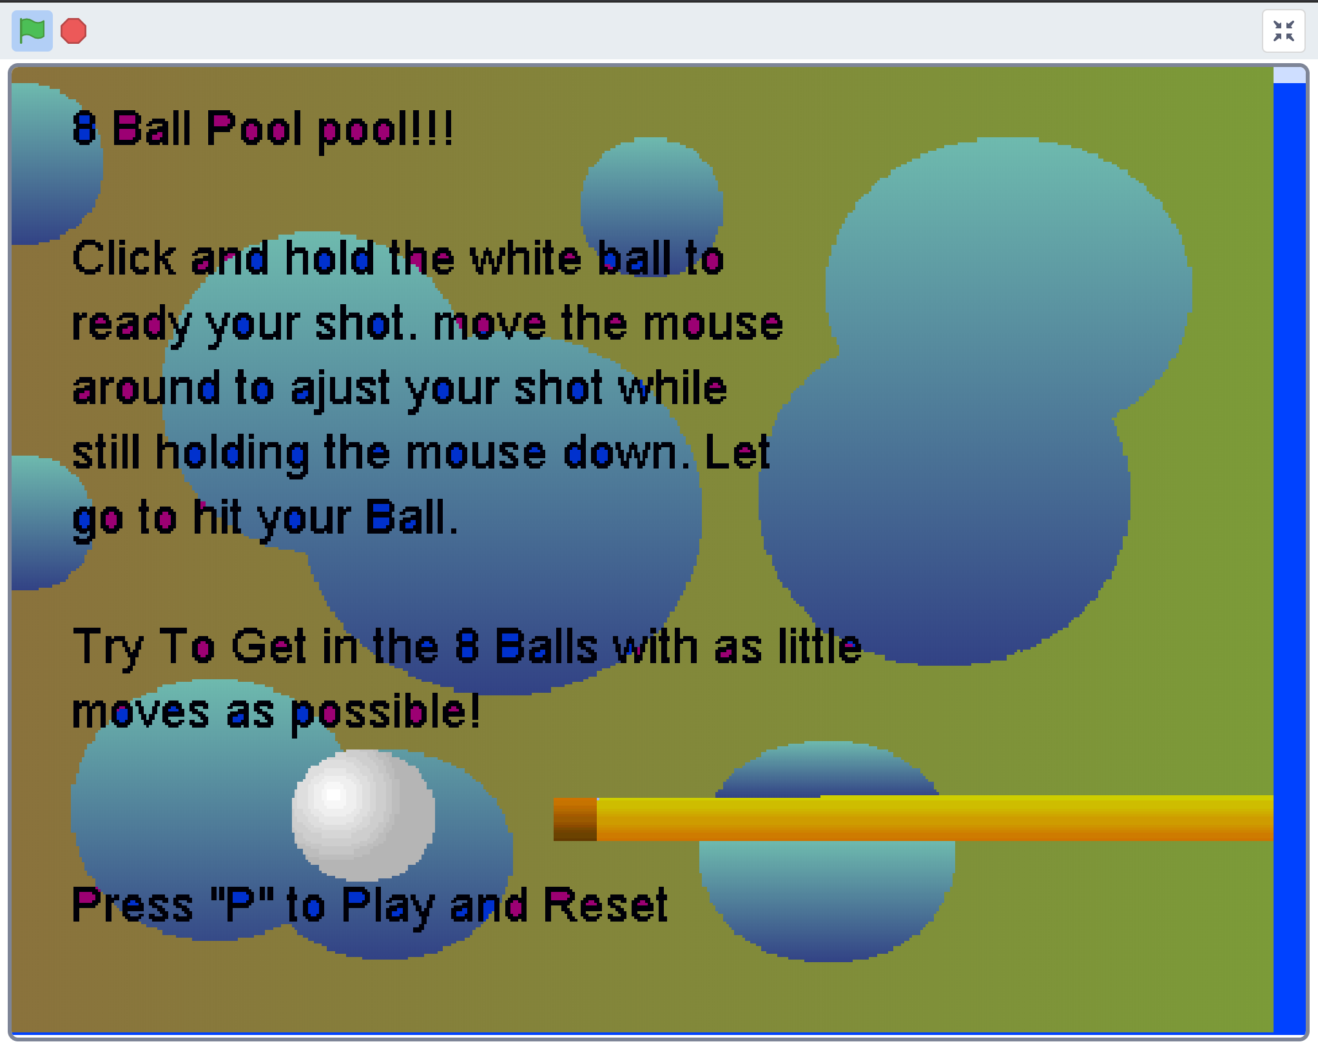
Project Description: MaKey MaKey Pool
MaKey MaKey Pool is a game that teaches students coding skills using “if-statements”, “while loops” and building blocks with Scratch.
MaKey MaKey will be used in place of the computer mouse/keyboard mousepad
Notes:
Created by: Taylor Williams

Slide 4
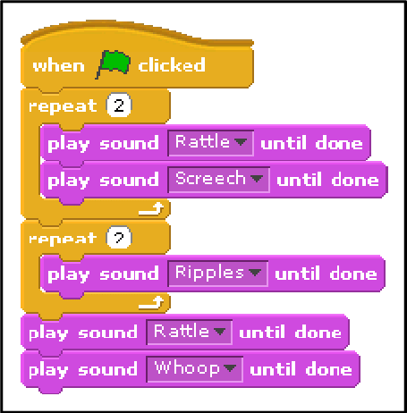
Technology Description: Scratch
Scratch is an interactive programming language that allows users to create interactive stories, games, and animations.
Event-driven, visual, block-based programming language
Created by MIT Media Lab in 2002
Notes:
Created by: Taylor Williams

Slide 5
Technology Description: How Will It Be Used
The participants will be able to learn about coding skills using “if-statements”, “while loops” by creating another level of the game.
Notes:
Created by: Taylor Williams

Slide 6
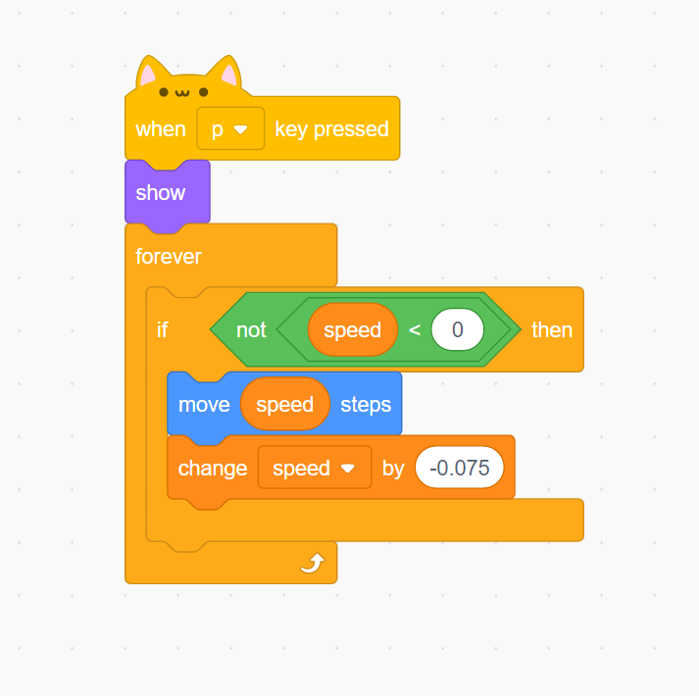
Project Goals: Teaching If-Statements
An if-statement is a block of code to be executed if a condition is true
Example:
"If you get an A, then your GPA will increase."
"If the speed is not less than 0, then the object will move 'speed' amount of steps and the speed will change by –0.075."
Notes:
Created by: Taylor Williams

Slide 7
Project Goals: Teaching While Loops
A while loop loops through a block of code as long as a specified condition is true
While loops in Scratch are called "forever loops"
Example:
"While you keep getting A's, your GPA will continue to increase."
"While the speed is not less than 0, the object will continuously move 'speed' amount of steps and the speed will change by –0.075. Once the speed is equal to or less than 0, the object will stop moving."
Notes:
Created by: Taylor Williams

Slide 8
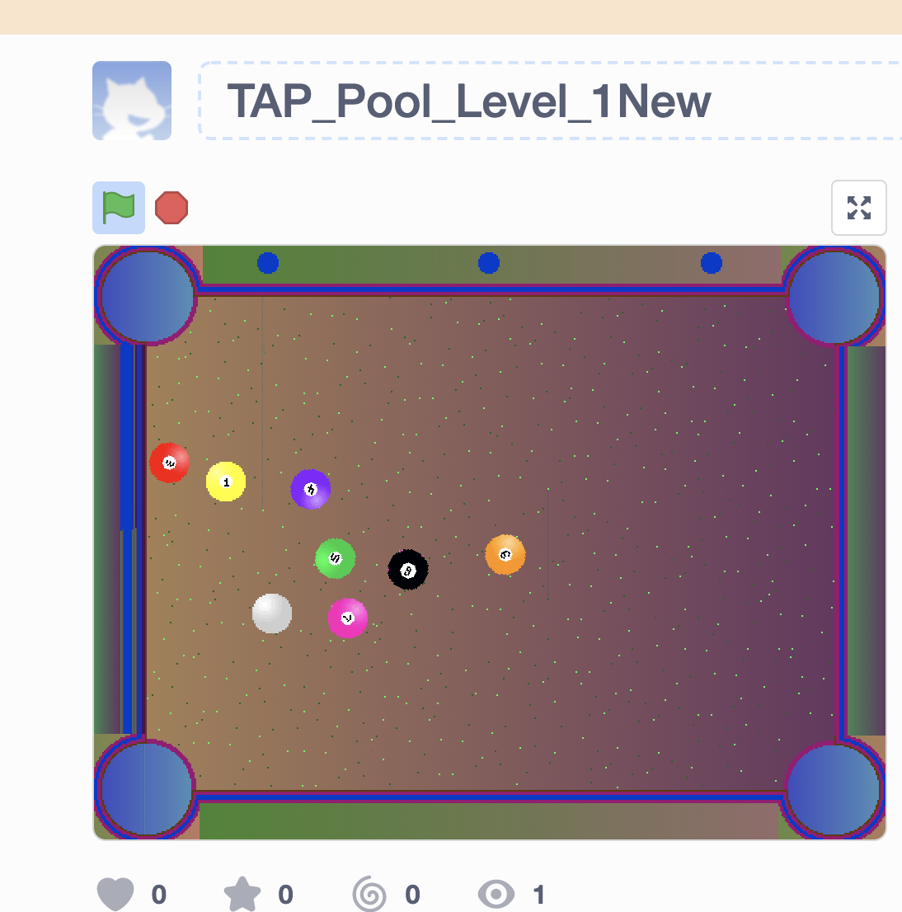
MAKEY MAKEY POOL
Makey Makey Pool is simple pool game
Link to the Scratch Page
Level 1 Video

